Slide 1

Using Machine learning for microrna biomarkers of renal carcinoma
Crowe Hanika Pandya
Bioinformatics

Slide 2

What am I doing?
Purpose

Slide 3

Purpose:
The purpose of this project is to use Machine Learning algorithms to analyze databases of microRNA expression in renal cell carcinoma tissues to find a biomarker for this cancer type and then further determine if it is downregulated or upregulated. Future prospects include therapeutic applications.

Slide 4
Why is it important
Reasoning

Slide 5
Importance:
Within this cancer type, there is a significantly small number of microRNA biomarker, it is only known that there is some gene error (Hernandez & Lucas ,2016).
The prospects of therapeutics can help not just this cancer type, but many others considering that the ability for microRNA to have a therapeutic ability has not been thoroughly looked at.

Slide 6
What is microrna
Project detials

Slide 7

Microrna:
Fragments of non-coding RNAs that play a key role in the regulation of gene expression via binding to target gene regions.
- Plays a role in the causation of diseases and cancers.

Slide 8
What is known and what is new
Project detials

Slide 9
Previously done research:
In correspondence to our cancer:
- No significant work done on microRNA as biomarkers in relation to machine learning.
- Discovered that miR-144-3p as a novel plasma diagnostic biomarker for renal cell carcinoma via experimentation (Lou et al., 2017).
How machine learning is being to identify microRNA (general):
- Using DeepMirTar, gene expression from miRNA was looked at within canonical or non-canonical seed and used to then provide a description for a target biomarker. (Loshikhes, 2018)

Slide 10
New about this project:
Uses the machine learning aspect that has not been done
Renal Carcinoma types have not yet been heavily investigated
Therapeutic opportunities

Slide 11
Materials and plan
Proccedure

Slide 12

matierals
Algorithms:
Random Forest
PicTar
Databases:
dbDEMC 2.0
miRCancer
Cell line:
CRL-1932 (available on ATCC)
Courses:
Coursera
Plural Sight

Slide 13
Plan
Using the databases and algorithms:
Use the data on microRNA expression to locate a common biomarker across subtypes of renal cell carcinoma.
Determine their existence with the aid of CRL-1932 cell line in the lab environment
Adjust the miRNA expression to test therapeutic abilities
Test for up or down regulation to modify

Slide 14

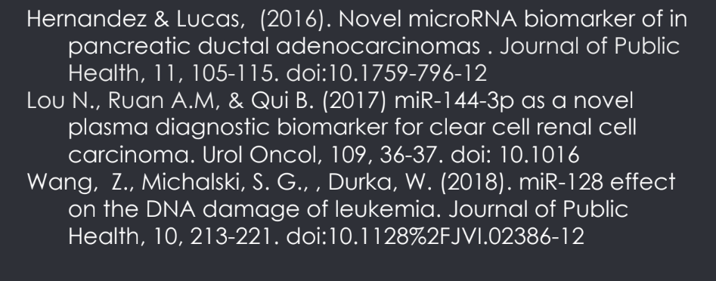
Slide Title
Thank you

